Slide 1

Networks and Internet COMP504
Cross over cable and Straight through cable

Slide 2

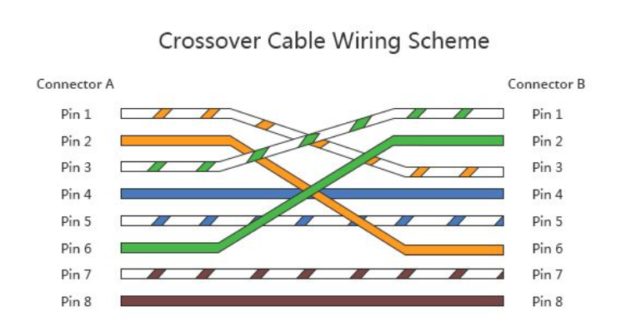
Cross Over cable wiring Scheme

Slide 3
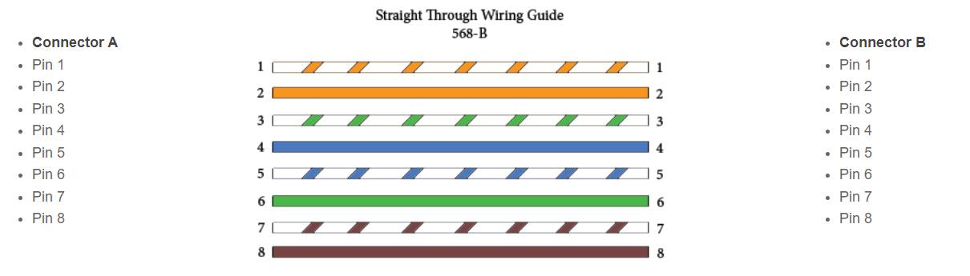
Straight Through Cable Wiring Scheme

Slide 4

Usages of Cross over and straight through cable
Cross-over cable when connecting two similar equipment, like switch-to-switch or router-to-router.
Basically, it can classify equipment into DTE (Data Terminal Equipment) and DCE (Data Circuit
Equipment). End-user stations are DTE (computers, laptops, Ethernet printers), while switching and
routing devices are DCE (switches, hubs, routers).
Cross-over cables are used to connect DCE-to-DCE, or DTE-to-DTE. However, some modern equipment is able to detect whether its peer is a DCE or DTE and whether the connection is using a cross-over cable or a direct-through cable and adjust properly. For example, Apple PowerBook, although it is a DTE, has the ability to connect to my switch using either a cross-over cable or a direct-through cable.

Slide 5
Example of Cross over and straight through cable usages
Router - Router = Crossover
Router - Switch = straight
Switch - Switch = Crossover
PC - PC = Crossover
PC - switch = straight
PC - router = Crossover

Slide 6
Thank you

